Slide 1
Linux OS Configuration 1
Darius Kianersi

Slide 2
Updates (CLI)
Commands:
apt-get update
apt-get upgrade
apt-get autoremove
apt-get autoclean
Restart (optional)

Slide 3
/etc/apt/sources.list
Specifies which repositories to download packages from (used by apt)
Should be configured before performing updates
Fields:
deb/deb-src (package format)
url
version "codename" (16.04 is xenial, 18.04 is bionic, etc.)
repository sections (separated by space)
Default config is most secure

Slide 4
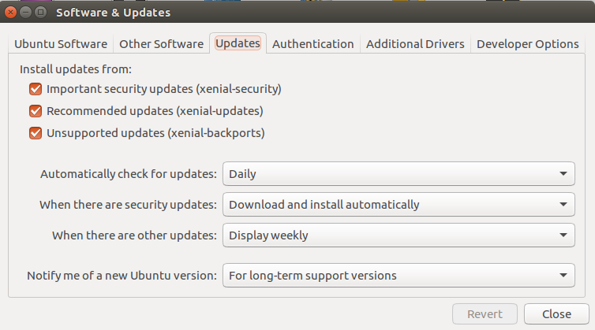
Automatic Updates

Slide 5
Ports
Communication endpoint
Used to identify a service/process
ftp | 21
ssh | 22
smtp | 25
http | 80
https | 443
smb/samba | 445
mysql | 3306
dns | 53

Slide 6
Firewall
Filters and controls traffic being sent to and from the network
ufw ("uncomplicated firewall")
ufw status
ufw enable
ufw --force reset
ufw allow [out] PORT
ufw delete NUM
ufw default deny incoming
ufw default allow outgoing

Slide 7
Firewall cont.
iptables
Flush: -F
Delete non-default chains: -X
General usage:
iptables -A [INPUT/OUTPUT] -p [tcp/udp] --dport PORT -j [ACCEPT/DROP]
iptables -P INPUT DROP
iptables -P OUTPUT ACCEPT
iptables -L -n --line-numbers
Save rules:
apt-get install iptables-persistent
netfilter-persistent save

Slide 8
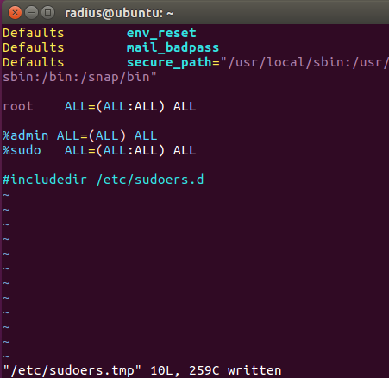
Sudoers
File that determines who can use "sudo"
"superuser-do"
/etc/sudoers /etc/sudoers.d/*
sudo visudo
Fields:
1: user/group
2: applies to all hosts
3: run cmds as all users
4: run cmds as all groups
5: applies to all commands

Slide 9
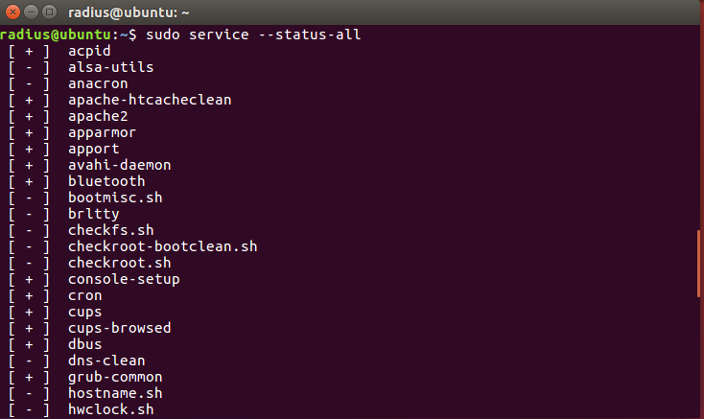
Services
service --status-all
service NAME stop
+ running
- stopped
? not managed by service

Slide 10
Cron
Scheduled tasks (ex: restart web server every 2 days)
cron service: runs cron jobs found in
/var/spool/cron
/etc/cron.d/*
/etc/cron.*
Commands:
Edit: crontab -e
List: crontab -l
-u USER

Slide 11
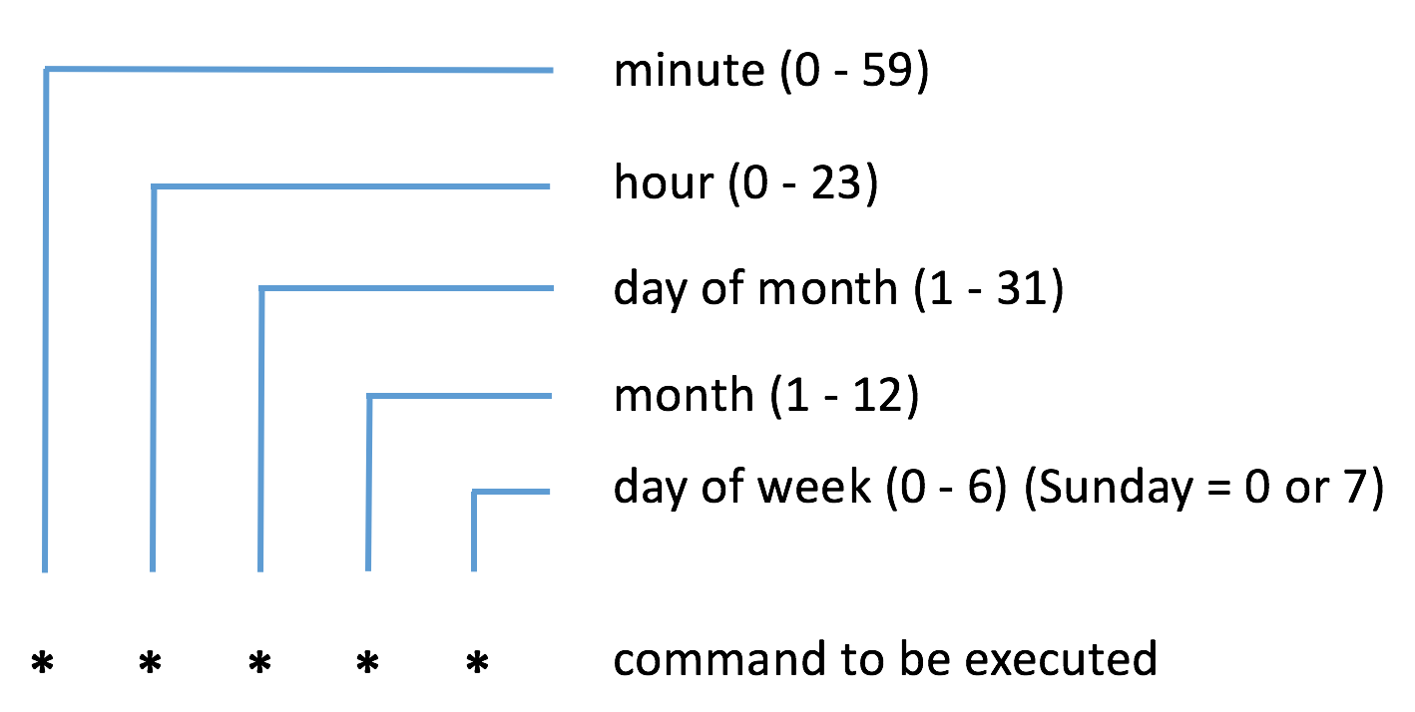
Cron Job
A scheduled task that is ran by the cron service
* denotes every _____
x-y denotes from x to y (inclusive)

Slide 12
Practice
Configure the firewall to allow incoming ssh connections
Stop the service "apache2"
0 0 31 10 * echo "spooky time" >> /home/radius/out.txt

Slide 13
Practice Answers
ufw allow 22 OR iptables -A INPUT -p tcp --dport 22 -j ACCEPT
service apache2 stop
Prints "spooky time" at 12:00 AM every October 31st

